Slide 1
Business objective overview
Manufacturing OT/IOT device Security
Visibility of OT/IOT Device types
Contextual policies applied
Consistent security policy for any and all devices/users

Slide 2
OT/IOT Device Security

Slide 3
Use case
OT/IOT Device Security – Configured once, applied everywhere, contextually aware
Key Benefits
Reduce operational complexity
Context and identity aware policy membership
Increased security and reduce the threat landscape using ZTNA principles
Reduced risk of lateral movement
Description
Configure global policies based on Device type, function and network/security framework (Perdue model/IEC62443)
Segment devices using LAN FW
Demonstrate advanced threat protection

Slide 4









How To Device Access Control – Centralized network
Level 4/5
Enterprise
Enterprise Apps
WAN Segmentation
Internet/Cloud Segmentation
Cato PoP
Information Technology
IT/OT Segmentation
LAN Segmentation
Level 3
Operations
File server
Jump server
Print server
Historian
Level 2
Control
Control Center
SCADA Servers
Operational Technology
Level 1
Process
HMI
PLC
HMI
PLC
HMI
PLC
Micro-Segmentation
Level 0
Physical Process
Field device
Sensor
Field device
Sensor
Field device
Sensor

Slide 5
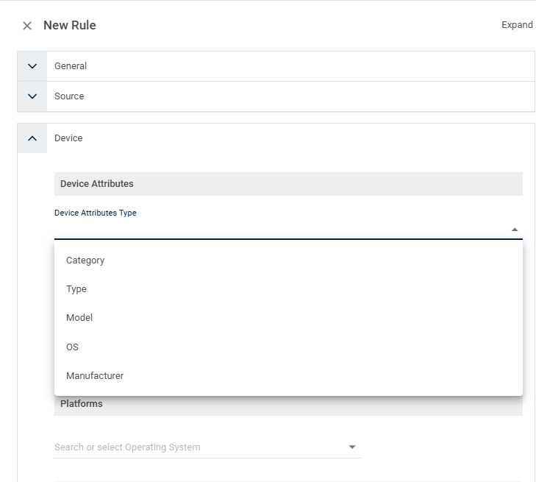
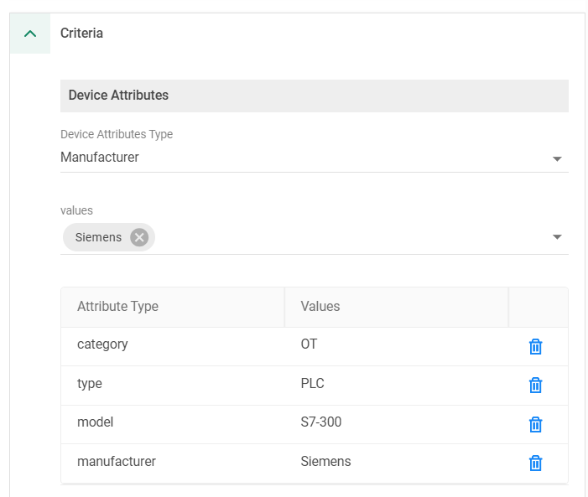
How To Access Control Based on Device Attributes

Slide 6
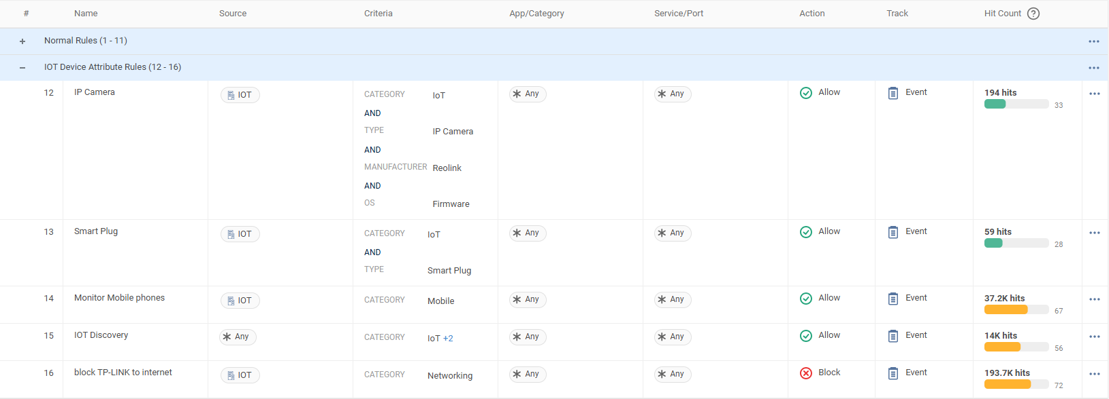
How To Access Control Based on Device Attributes

